Slide 1




TEAM Amplifier
HACKTOBERFEST 1.0

Slide 2






Problem statement
Fake news detection system
Fake news can influence public opinion and decisions, including elections and policy choices. Addressing this problem is crucial for ensuring that informed, evidence-based decisions are made.

Slide 3
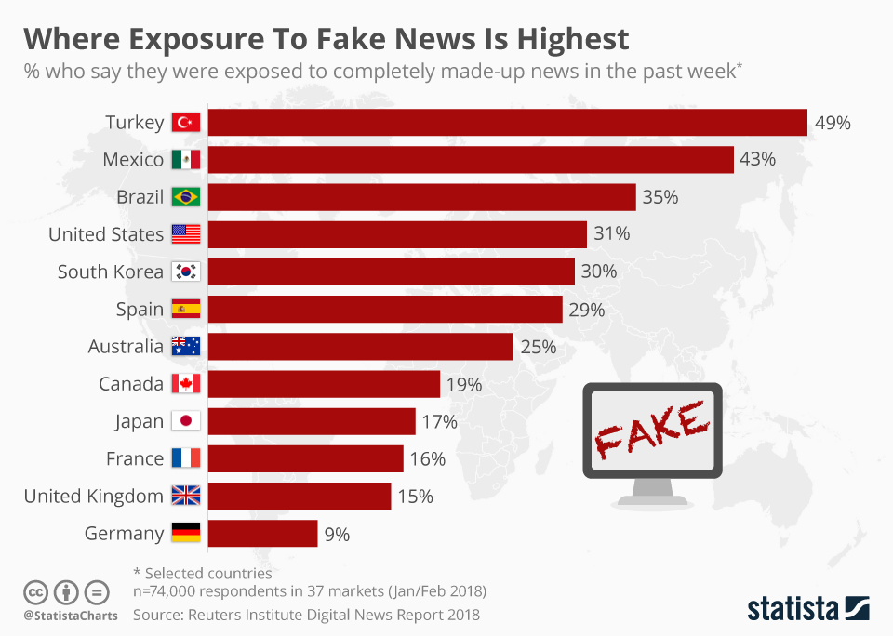
Problem statement
This is one of the statistical data which shows the impact of the fake news around the world.
Fake news can influence public opinion and decisions, including elections and policy choices. Addressing this problem is crucial for ensuring that informed, evidence-based decisions are made.

Slide 4




Solution
We will build a Fake news detection model usinf GNN- ML model. This will detect the fake news available in the given dataset.
Futher we will integrate the model with the AWS, a well know cloud platform and which is adopted by many industries around the world.

Slide 5


Key Features and Functionality
1. News Article Classification
2. Machine Learning Model: - by building and traning the model
3. AWS Integration: Integrate the system with AWS services, such as S3 for dataset storage and SageMaker for model deployment, DynamoDB for storing user responses, CloudTrail for scaling, and monitoring.
4. User Interface: Create a user-friendly web interface or application for users to interact with the system. Users should be able to input news articles or links and receive real-time classification results.
5. Scalability: Plan for scaling the system as the volume of data and user demand grows. Ensure that the system can handle increased loads without compromising performance.
CUSTOMIZABLE SETTINGS TO TAILOR USER EXPERIENCE.

Slide 6


Social impact
To mitigate the spread of fake news and misinformation, thereby fostering a more informed, trustworthy, and resilient information ecosystem.
We can identify ways to track social impact by:
1. Accuracy Metrics
2. Time-Based Analysis
3. User Feedback and Reporting.
We shall have a clear mission and vision statement that outlines our commitment for addressing the issue of fake news and its impact on society.

Slide 7


Scope of the Model
Fake News Detection model has the potential to make a significant and positive social impact, creating value for society and contributing to a better world
1. Preservation of Truth and Trust.
2. Informed Decision-Making
3. Reducing Public Confusion and Panic
4. Public Health and Safety
5. Democracy and Fair Elections

Slide 8
Revenue Model
1. Charge users based on their actual usage of the service. For example, users could pay per article analyzed or per API call made to your service.
2. License your fake news detection dataset or API to other businesses, researchers, or media organizations.
Charge fees based on the volume of data or API requests.
3. Offer a free version of your service supported by advertisements.
Generate revenue from advertisers who want to reach your user base.
4. Offer advanced analytics and reporting services to businesses, media outlets, or government agencies.
Charge fees for customized reports, data insights, and trend analysis.
5. Collaborate with research institutions and organizations to provide data analysis and research services.
Charge fees for research projects and custom data analysis.

Slide 9



Technologies Used
OUR TEAM UTILIZED A VARIETY OF TECHNOLOGIES INCLUDING PROGRAMMING LANGUAGES LIKE Python, Machine Learning AS WELL AS TOOLS LIKE Amazon Web services (AWS) and Github.

Slide 10



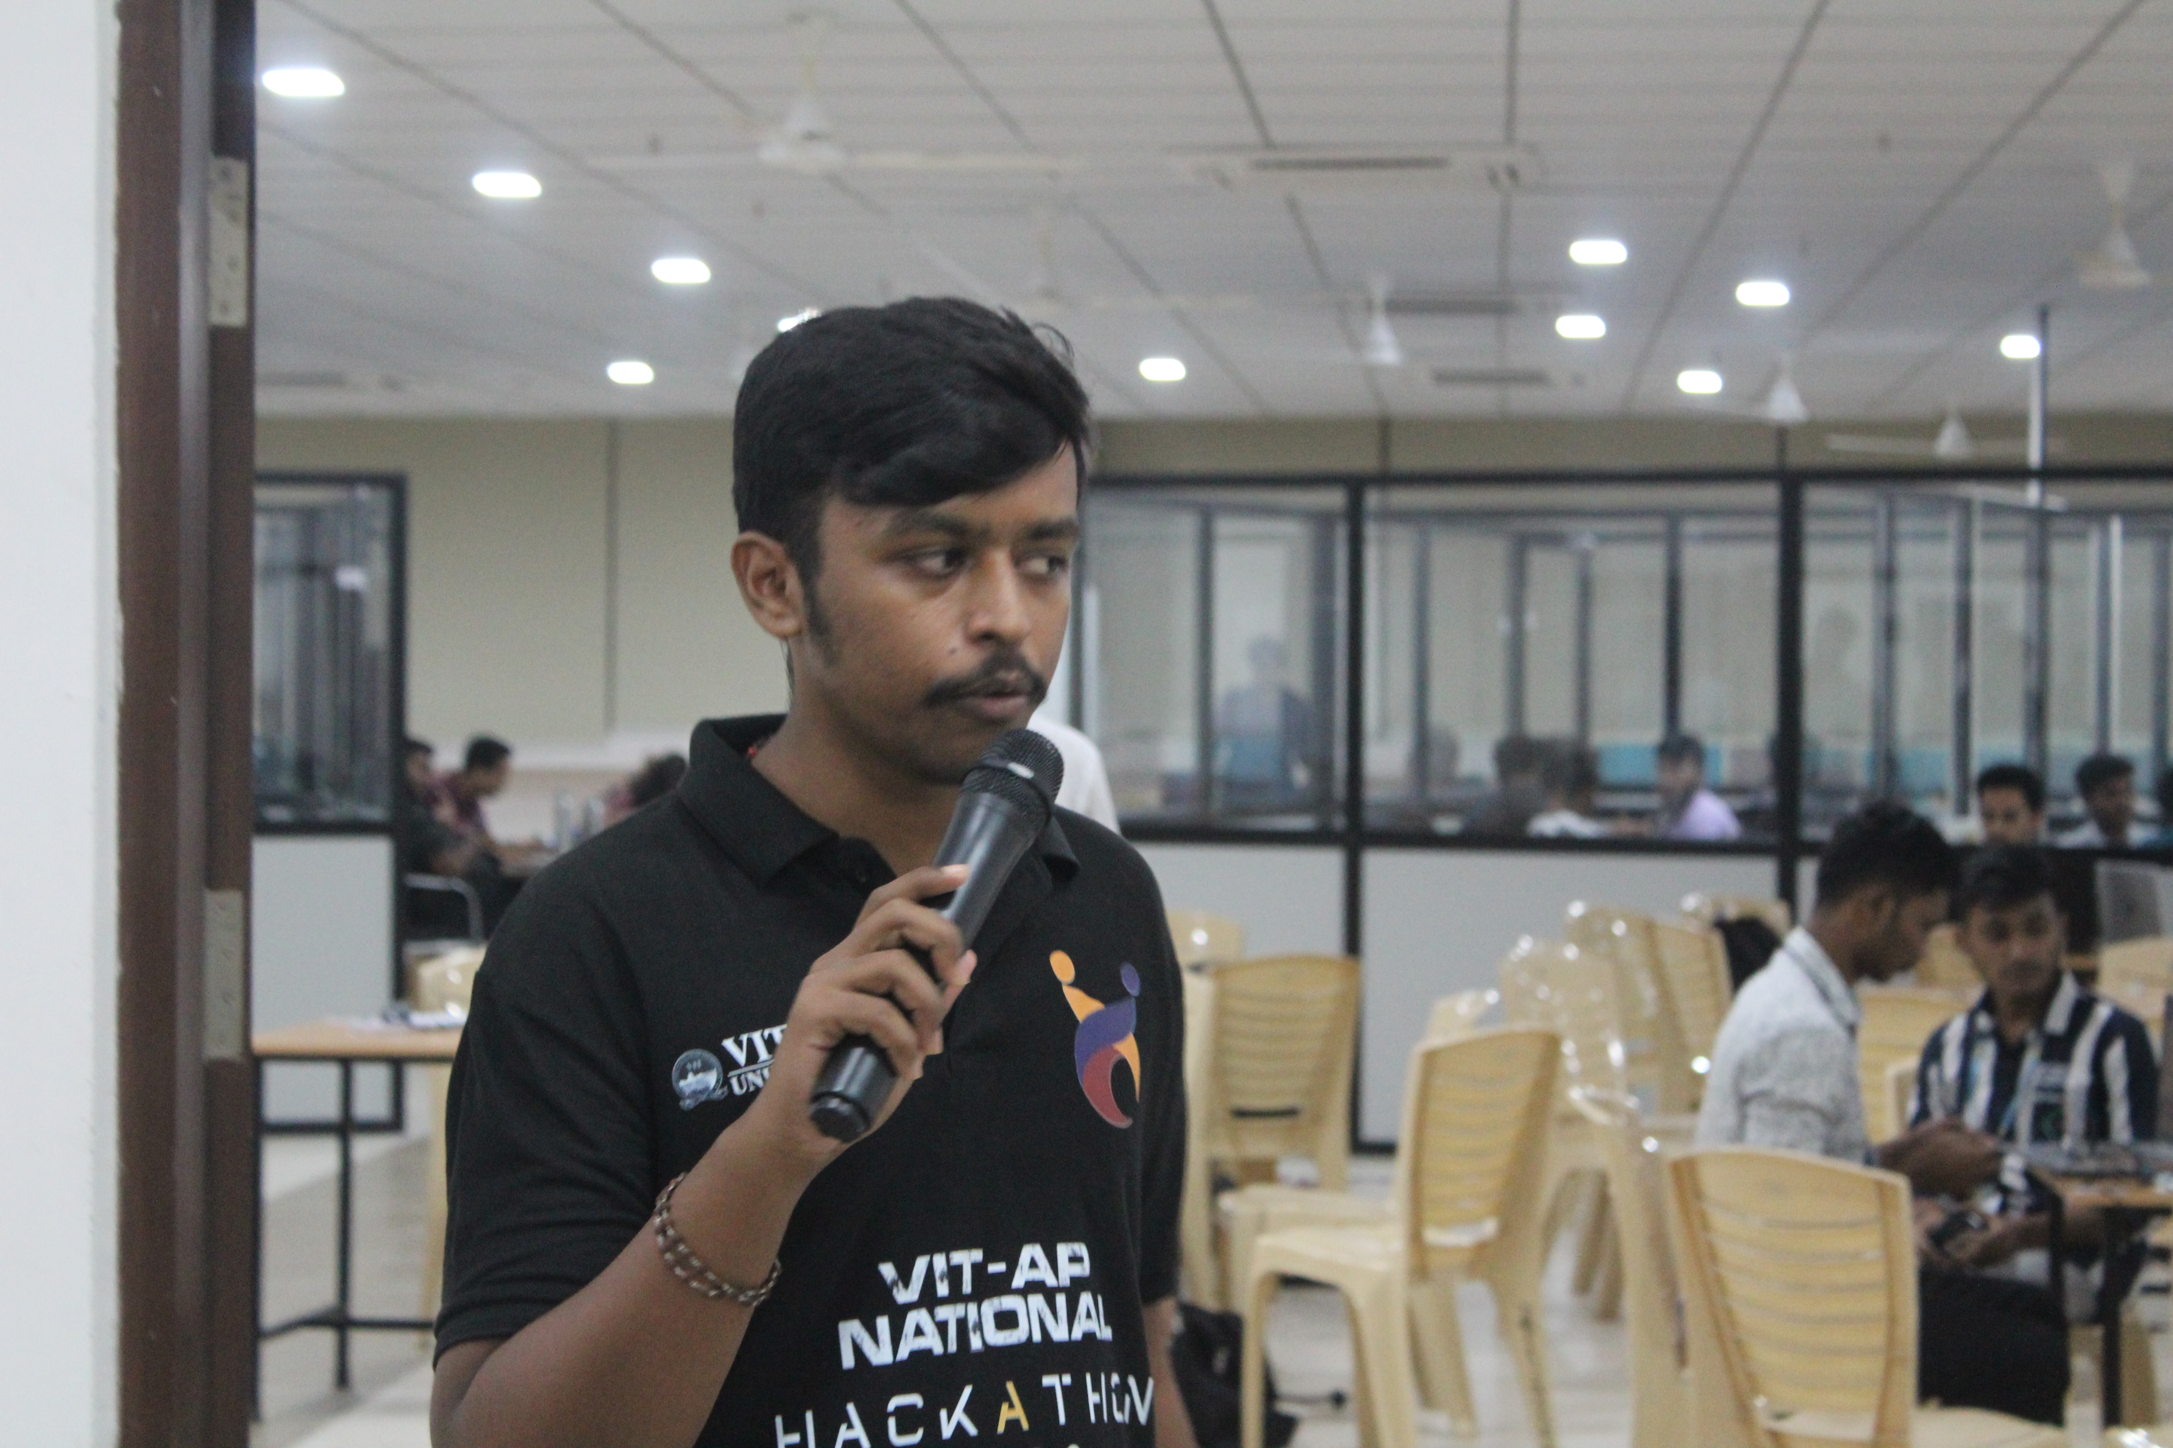
The Team
Navya
Preetham
Vyshanvi
21bce7191
21BCE7945
21BCE7949

Slide 11


Thank You
HACKTOBER FEST

